Slide 1
Social Media Sentiment Analysis

Slide 2
Contents: 1. What is ML 2. Requirements 3. Components 4. Supervised Vs Unsupervised 5. Classification Vs Regression 6. Naïve Bayes 8. Comparison 9. Conclusion 10.References

Slide 3
What is Machine Learning..?
Machine learning is type of artificial intelligence (AI) that provides computers with the ability to learn without being explicitly programmed.
The Machine that Teaches Themselves.

Slide 4
Things Require for ML
Machine Learning Library
Data
Algorithm

Slide 5
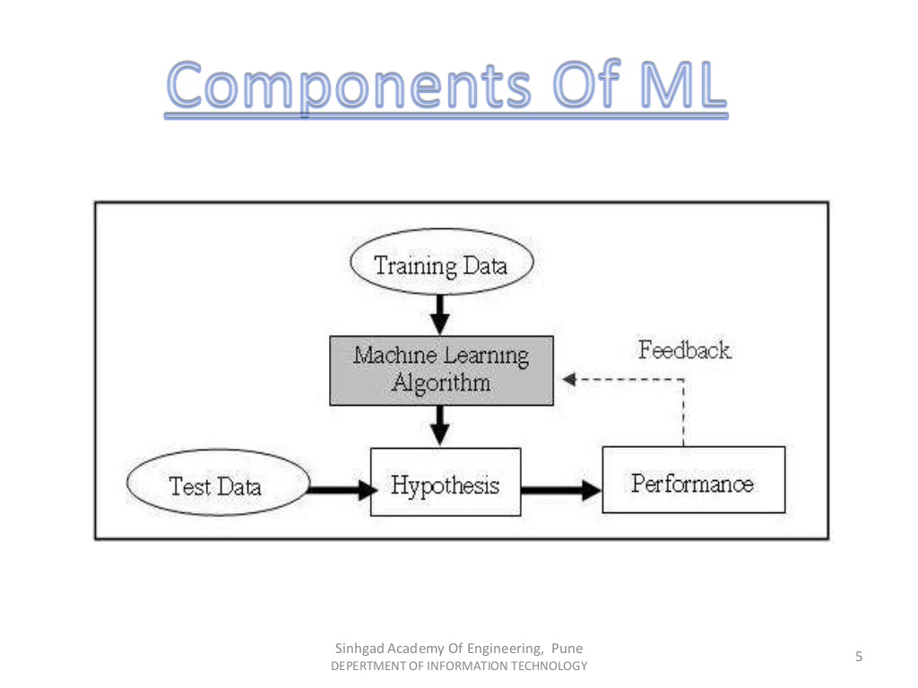

Slide 6
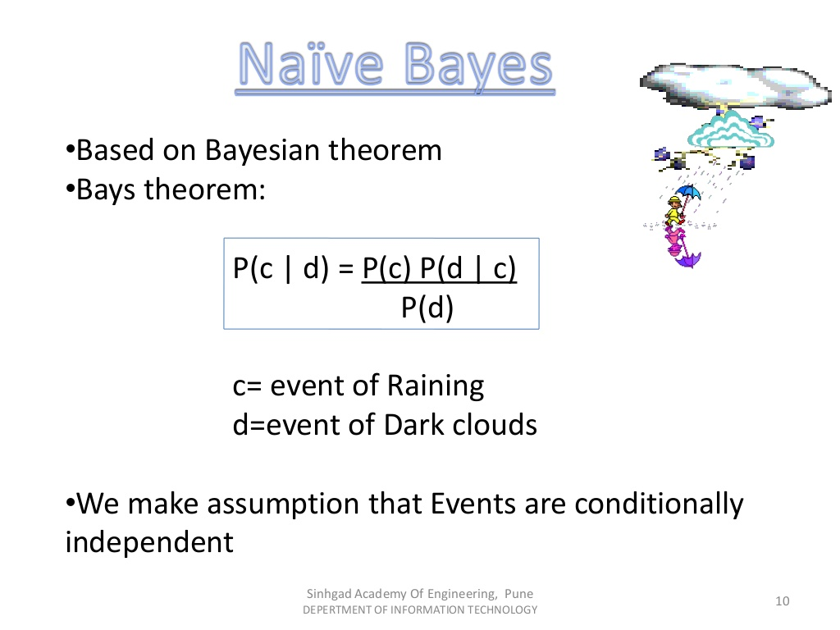
Naïve Bayes

Slide 7
P(C/D): probability of occurrence of evet C given the event D is true.
P(C) and P(D): Probabilities of the occurrence of event C and D respectively.
P(D/C): probability of occurrence of evet D given the event C is true.
Briefly Explanation:
C is Called proposition and D is called the evidence.
P(C) is Called the prior Probability of proposition and P(D) is called the Prior probability of evidence
P(C/D) is called the Posterior.
P(D/C) is the Likelihood.
Posterior=(Likelihood)(Proposition prior probability) Evidence prior probability

Slide 8
Random Forest Algorithm
Random forest is most popular and most powerful supervised machine learning algorithm.
There is very helpful for Regression and Classification task.
Random forest classifier will handle the missing values.
Random forest prediction
Takes the test features and use the rules of each randomly created decision tree to predict the outcome and stores the predict outcome
Calculate the votes for each predicted target.
Consider the high voted predicted target as the final prediction form the random forest algorithm

Slide 9
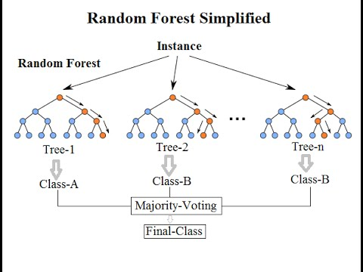

Slide 10
XGBoost
Gradient boosting is a machine learning technique for regression and classification problems, which produces a prediction model in the form of an ensemble of weak prediction models, typically decision trees.
A better version of gradient Boosting (Collection of Weak trees, weighing the difficult cases more heavily
Steps:-
GET DATA , EXAMINE DATA, & PREP DATA
TRAIN,EVALUTE ,& PREDICT

Slide 11


XGBoosting
Each thread is weak
But many thread combine and create a rope this is not weak
Similarly Ensemble models combines many models (called weak learner / weak models ) and creates a powerful model (called strong learner)
Decision tree is one of the most popular choice of such ensemble models

Slide 12
Comparison
Naïve Bayes | SVM | Maximum Entropy
Easy to Implement | Harder to Implement | Harder to Implement
Less Efficient ,Efficient due to working with large sets of words | Efficiency is maximum | Efficiency is moderate
Limited Use | Versatile used in Comp Vision, Text Cat, IP | Hardly Used

Slide 13
Conclusion
The machine learning can prove efficient over traditional techniques for SA
The Naïve Bayes can be useful in sentiment analysis of text categorization.

